Slide 1
SEAGrid: A Science Gateway for Chemistry and Materials Research
Sudhakar Pamidighantm
pamidigs@iu.edu
17 Oct 2017

Slide 2
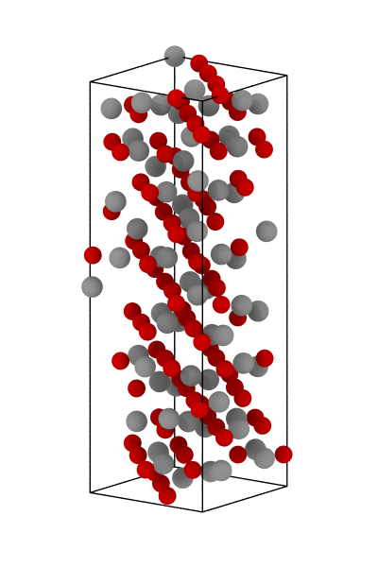
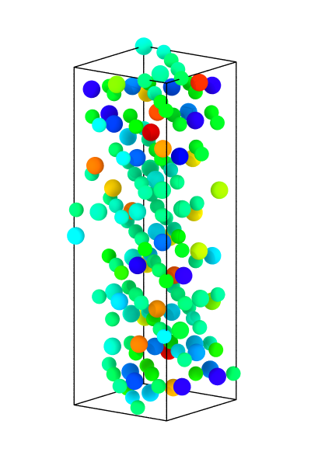
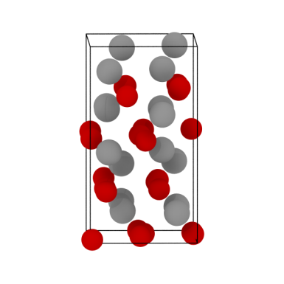
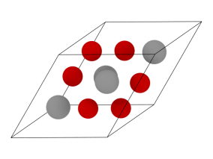
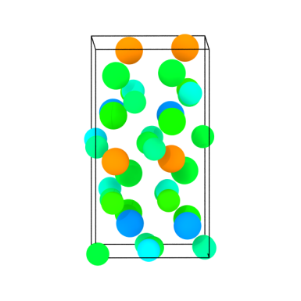
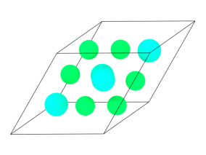
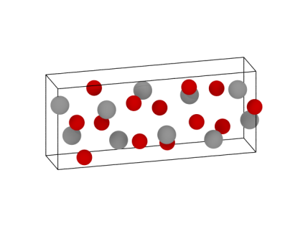
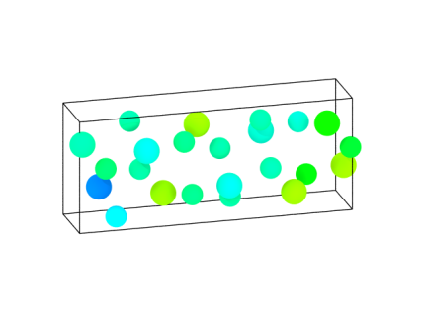
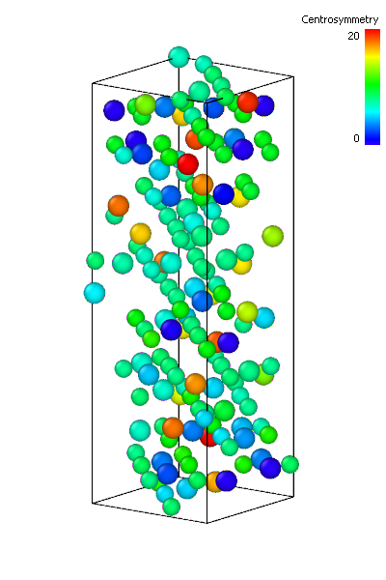
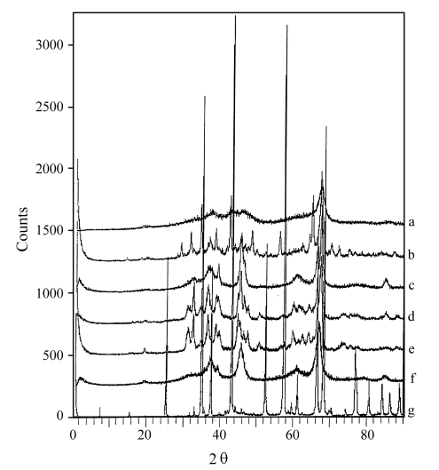
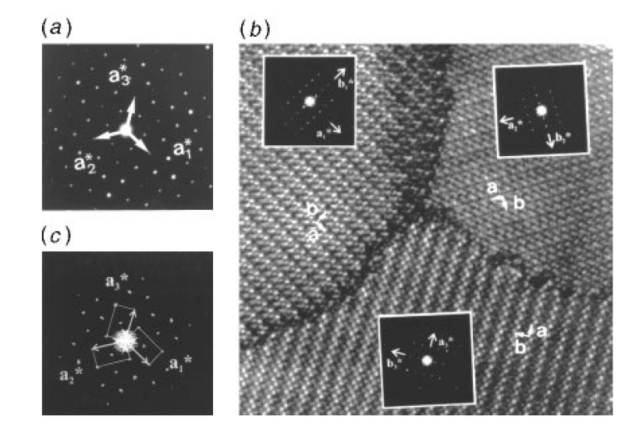
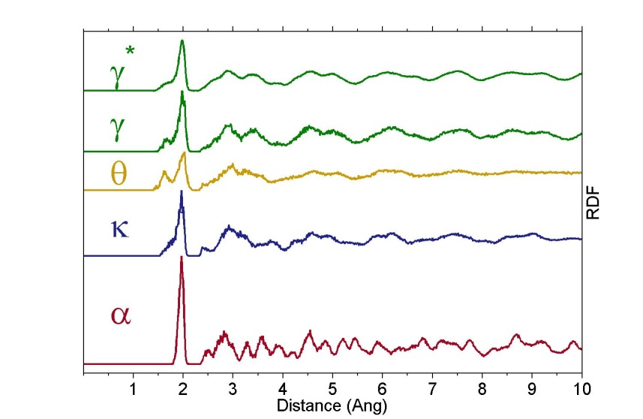


X-ray Diffraction of Bulk Alumina
Characterization methods for non-cubic crystals in atomistic simulations are limited
Alumina Phases
Centrosymmetry analysis shows no clear differentiation between phases
Radial distribution function cannot differentiate between transition phases
γ
κ
α
θ
XRD
of Alumina Phases
SAED and HRTEM
of 120° twining in κ-Al₂O₃
Centrosymmetry(Å²)
0
5
10
15
20
Radial Distribution Functions
Our objective is to develop an atomistic method to compute x-ray and electron diffraction patterns
(Santos et al. 2000)
(Ollivier et al. 1997)

Slide 3

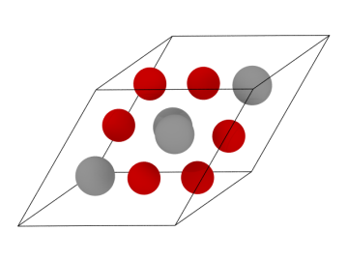





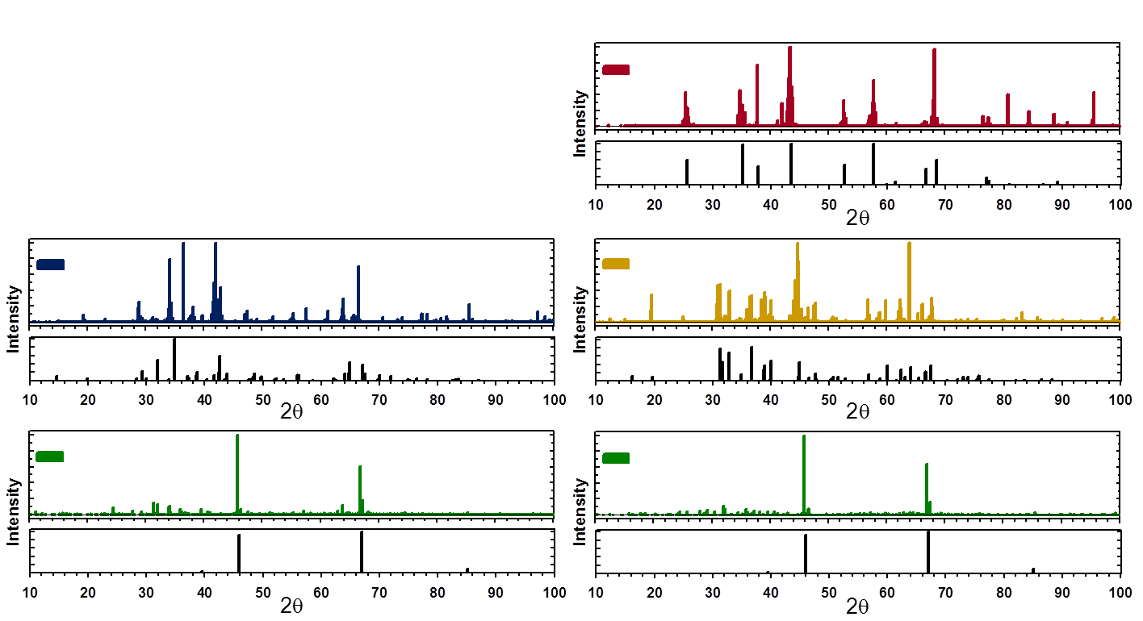
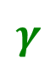

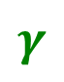

Application: Phase Identification in Alumina
Virtual diffraction can distinguish between alumina phases
γ
κ
α
Al₂O₃ phases modeled with the ReaxFF potential
(Sen et al. 2013)
θ
Coleman and Spearot (2014) Acta Materialia, Volume 82, 1 January 2015, Pages 403–413
.
Intensity
Intensity
Ishizawa (1979)
Ollivier (1997)
Intensity
Intensity
Husson (1996)
Verwey (1935)

Slide 4
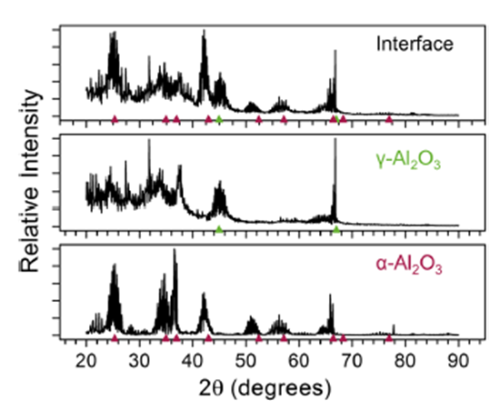
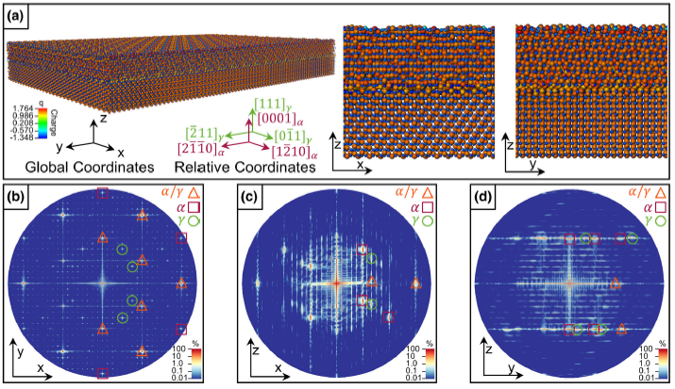
Line profiles, Structures and SAED Patterns for heterogonous α-Al2O3 (0001)/γ-Al2O3 (111) interface
Coleman et al. 2014, JOM 66, 408
The colored triangles are positioned at experimentally determined peak locations for bulk α-Al2O3 (red) and γ-Al2O3 (green)33.
Notes:
What are circles?

Slide 5
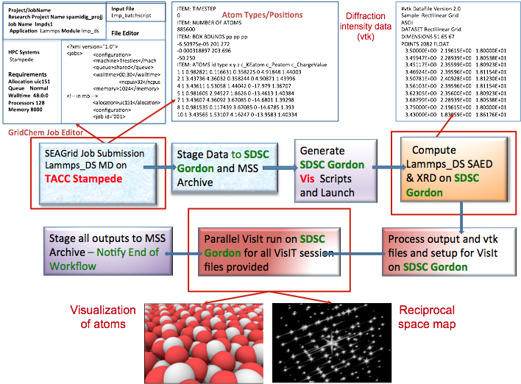
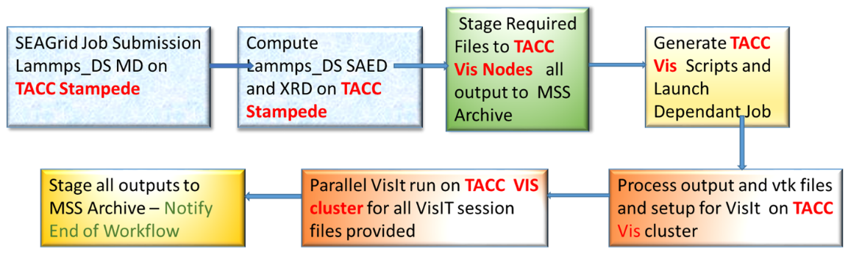
Workflow and Visualization An XSEDE ECSS Project
For large memory calculations a workflow is required to use the appropriate XSEDE resource
TACC Stampede: Atomistic simulation of alumina
SDSC Gordon: Calculation of diffraction intensities + Visualization
Workflow implemented through SEAGrid Science gateway
Supports a private “DS” LAMMPS build
Supports single jobID handle for multiresource job submission
Supports the development of a XML script for high throughput job submission
Compatible with parallel VisIt executions so that diffraction pattern generation is automated
Workflow to run on TACC resources only

Slide 6
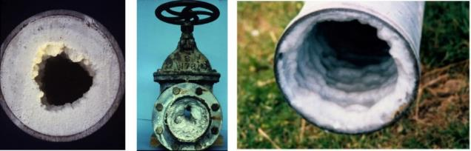
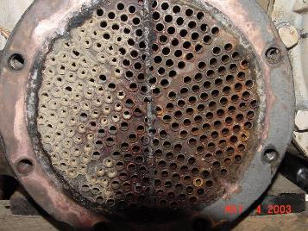
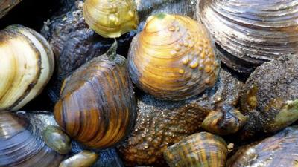
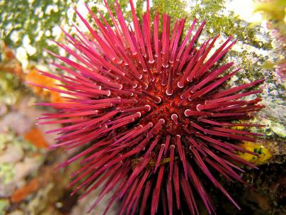
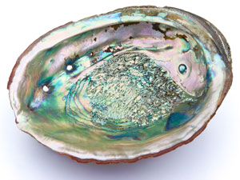
Biomineralization
Calcium Carbonate in Industrial Processes: Pipe scaling and Heat exchanger fouling
CaCO₃ enables: Tough structures Self-healing and Growth

Slide 7
Why do we study the biomineralization of calcium carbonate?
Marine invertebrates
Engineering Composites
Commonly present in majority of invertebrate skeletal tissues
On-demand, highly controllable crystallization of ACC reservoirs
Stable amorphous and crystalline products
Abundant(..therefore inexpensive!)
Tunable(use engineered biomimetic polymers)
Attractive mechanical properties
Inorganic-organic composite materials:
Amorphous calcium carbonate + organic phase → Tough, strong composites
At SIEN-UIUC:
Understand mechanistic effects of organic additives during surface nucleation and growth of CaCO₃
Synthesize and characterize amorphous CaCO₃ composites, as novel materials
Notes:
So if we look at the behavior of these invertebrates and what we look for in engineered materials, we see that there is significant overlap!

Slide 8
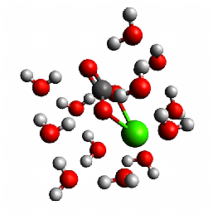
Calcium Carbonate Hydration Shell
CaCO₃.12H₂O
B3LYP 6-311G(d,p)
Lopez-Berganza, et al. J Phys. Chem. A(2015)
Notes:
These graphs shows a quick snapshot of our approach. For a hydrated caco3 clusters, we are able to determine its first hydration shell, look at the thermodynamics involved and calculate a solvation free energy. We now have a better idea of the energetics that may be involved in the initial stages of the formation of calcium carbonate.

Slide 9


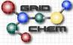
Calcium Carbonate Hydration
CaCO₃.xH₂O Initial guess
Stampede Supercomputer
TINKER
Monte Carlo Molecular Mechanics
(Minimize Torsional Energy in <20,000 steps)
TACC Stampede
DFTB+
Approximate DFT-Based
x=x+1
-2-3 CaCO3 Equilibrium Structures
-Thermochemistry (E,H,G, etc.)
-Vibrational Frequencies
SDSC Trestles
Gaussian09
Ab initio Quantum Chemistry
Lopez-Berganza, et al. J Phys. Chem. A(2015)
Notes:
Our approach uses a combination of MM to identify low energy candidates(which avoids any water placement bias). These candidates were then further optimized with more rigorous methods(DFTB+ and Gaussian 09). This approach gave us not only equilibrium structures, but also the thermochemistry of the clusters.

Slide 10
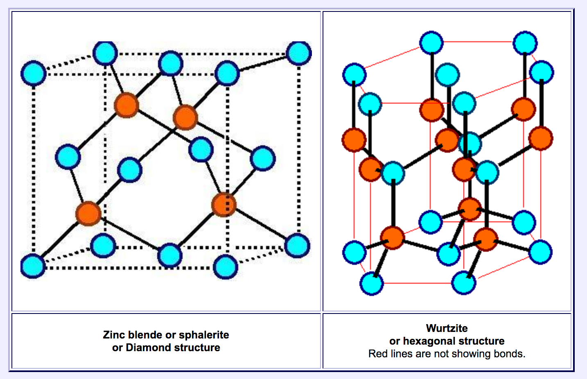
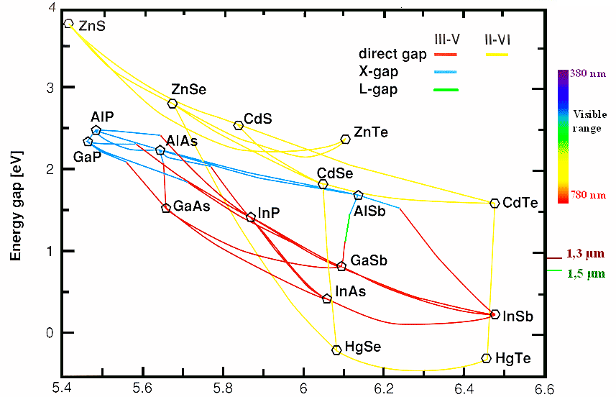
HgSe/HgTe Structures and Properties Zinc Blende/Wurtzite Structures and a Semimetal and Topological insulators
Notes:
A semimetal is a material with a very small overlap between the bottom of the conduction band and the top of the valence band. According to electronic band theory, solids can be classified as insulators, semiconductors, semimetals, or metals. In insulators and semiconductors the filled valence band is separated from an empty conduction band by a band gap. For insulators, the magnitude of the band gap is larger (e.g. > 4 eV) than that of a semiconductor (e.g. < 4 eV). Metals have a partially filled conduction band. A semimetal is a material with a very small overlap between the bottom of the conduction band and the top of the valence band. A semimetal thus has no band gap and a negligible density of states at the Fermi level. A metal, by contrast, has an appreciable density of states at the Fermi level because the conduction band is partially filled
Topological insulators (TIs) represent a novel state of matter: the bulk (3D) of a TI is electrically insulating, but the surface (2D) contains topologically protected conductive states
Such as Majorana Fermions and for spin-protected surface conduction in spintronics and quantum computing.

Slide 11
Alloying trends in electronic structure of Hg_{x}Cd_{1-x}Se
Notes:
Overview of alloying trends in electronic structure of HgxCd1-xSe. (a) Dependence of the calculated band gap on the Hg fraction, x, of the alloy. The arrow marks the furthest extent to which alloying has been achieved in our Cd2+ to Hg2+ cation exchange experiments. The horizontal dotted line marks the magnitude of thermal broadening at room temperature, which allows demarcation of the regime of room temperature 3D TI behavior (cyan) from that of topological semi-metal behavior (red). (b) The cation (combination of Hg2+ and Cd2+) s orbital character contribution to the frontier bands as a function of Hg fraction, x. ‘SO band’ refers to the Г7 SO band and ‘Hole Bands’ refers to the combination of the Г8 lh and Г8 hh bands, which are treated as one for this analysis. (c) Schematic of the band structure showing inversion and then shift of the Г6 s-like band downward in energy as heavy Hg nuclei are incorporated into a CdSe lattice. (d) Calculated charge density maps for the Г8 hh band at representative compositions. At the pure CdSe and HgSe end points, the Г6 s-like band is well separated in energy from the Г8 hh band and does not donate any s character to the Г8 hh band. However, at intermediate compositions, such as in Hg0.25Cd0.75Se, significant cation s character can be observed in the Se p dominated Г8 hh band.

Slide 12
Quantum Espresso Workflows
Multiple modules in QuantumEspresso
Extract prefix (basename) from input
If job is a continuation of previous run get the previous JobID
Run pw scf run (pw.x)
Run non scf single point run
Run Bands
Run 3d plot of wavefunctions for Xcrysden

Slide 13
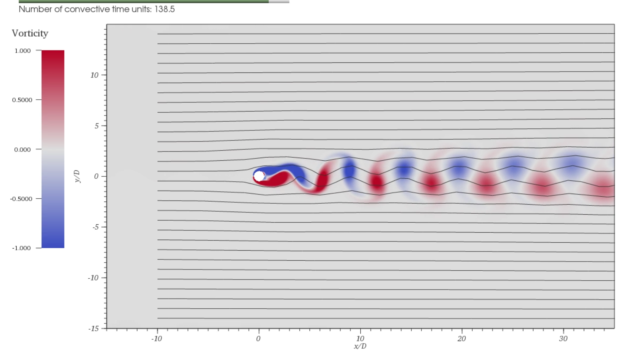
Nek5000 Based Vortex Shedding Workflow http://js-172-83.jetstream-cloud.org/vortexshedding/
Workflow Contains multiple steps
Multiple Input File staging
Extraction of canonical(base) name and creating additional inputs
Prepare mapfile
- prepare genmap input
4. Run genmap to generate meshmap
(run Genbox to generate a tensor product boxes from .box file)
5. Compile nek5000 with user subroutines and parameters and load
6. Run nek5000 for production
7. Prepare Visit inputs and Environment
8. Run Visit for individual images
9. Run ffmpeg for making a movie
10. Archive images and movies with metadata in SeedMe.org

Slide 14
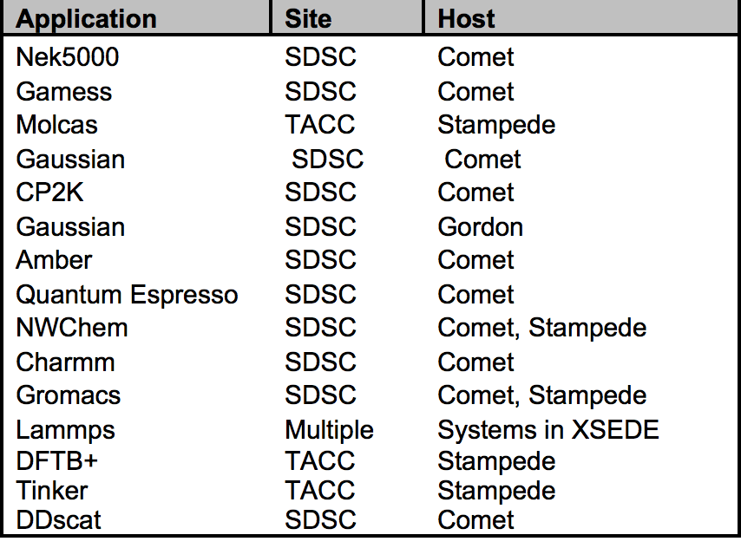
SEAGrid 12 Years in Service
XSEDE Gateway Allocation
XSEDE Resources SDSC, TACC, PSC, IU
Bigred2 (IU) and Karst (IU)
900 Registered Users, ~ 150 Active
63M XD SUs for 70K Jobs Since 2015
50 Publications since 2015
Mainly Chemistry Applications
Desktop Client for Pre and Post processing
Dynamic Information Services (RSS, HPC Load
data, Queue Prediction) Inherent workflow
capability – Checkpoint Reuse, High throughput
and Coupled Applications
Allocations, PI specific user and resource management and Job level usage monitoring
Consulting – Adaptive Services,
Data Archive

Slide 15
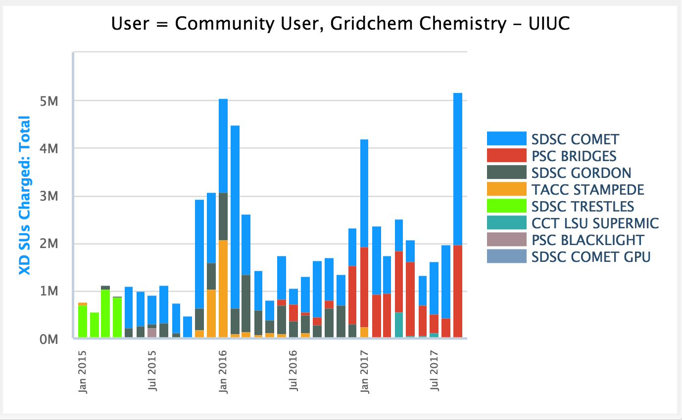
Usage

Slide 16
SEAGrid User Services
Allocation
https://www.gridchem.org/allocations/index.shtml
Community and External Registration
Reviews, PI Registration and Access Creation
Community User Norms Established
Consulting/User Services
https://www.gridchem.org/consult → SEAGrid.org/pages/contact
Ticket tracking, Allocation Management
Documentation, Training and Outreach
https://scigap.atlassian.net/wiki/display/SEAGrid/
FAQ Extraction, Tutorials, Dissemination
Help is integrated into the GridChem client
PIs can get upto 50K SUs (CPU Hours) a year
They can get/use their own allocations as well
External allocations can be serviced through community allocation login if they are associated.

Slide 17
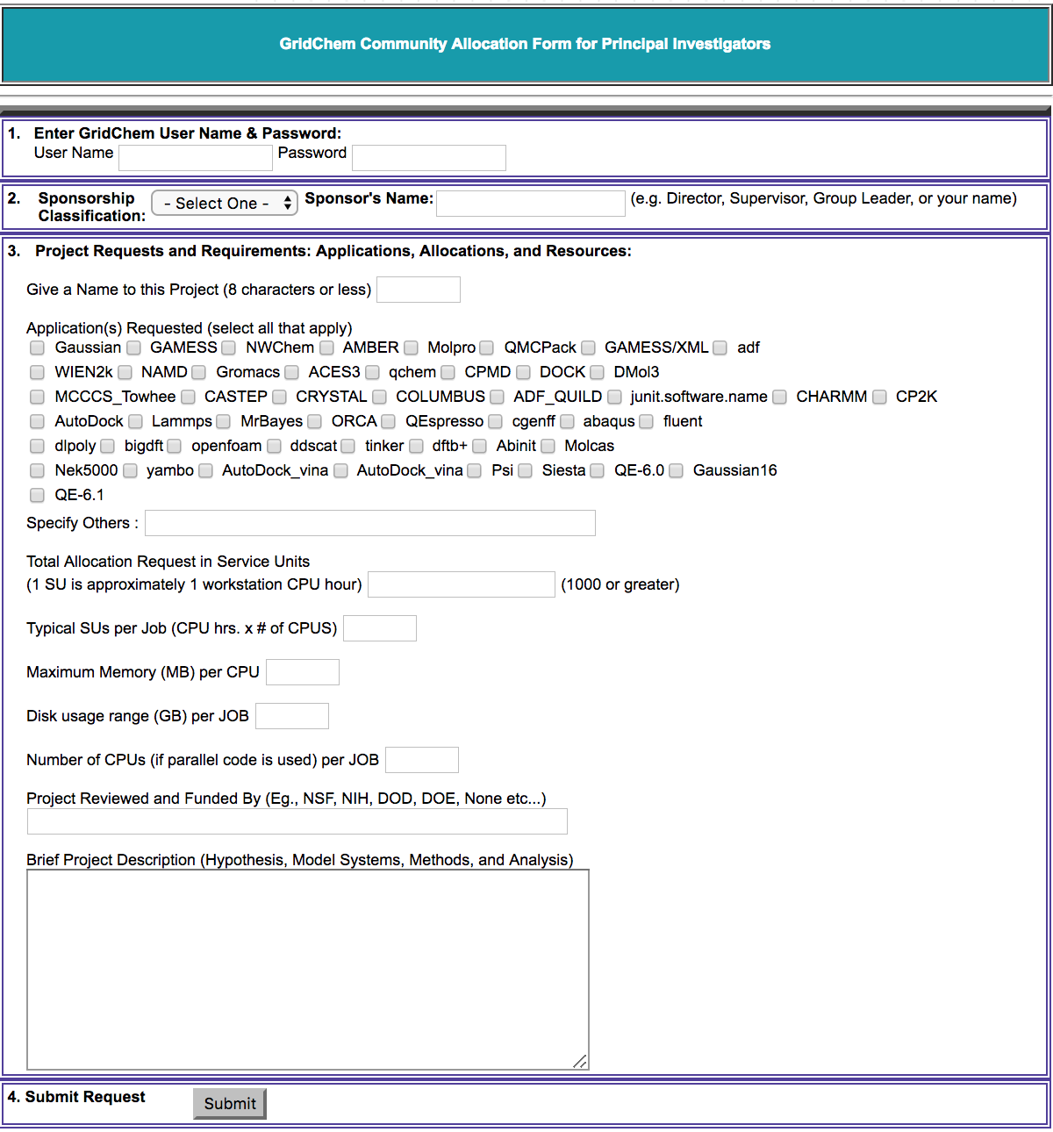
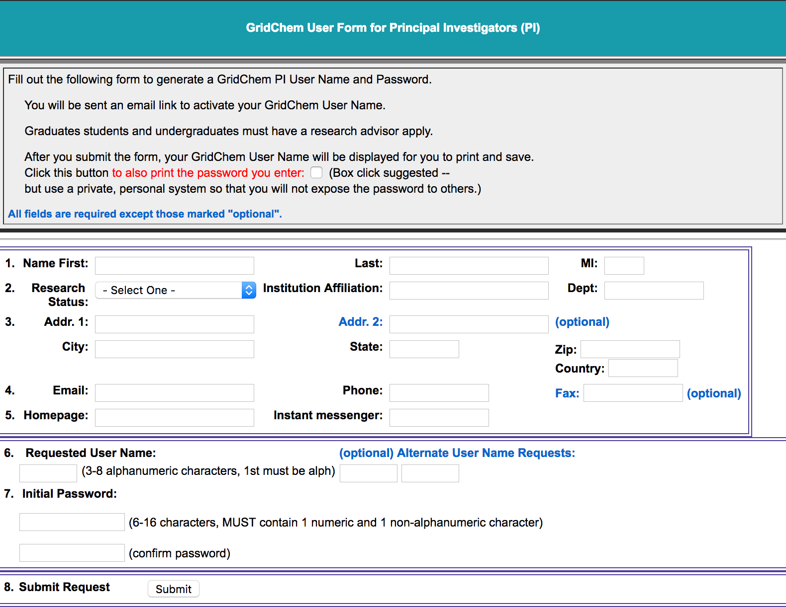
Allocations Request

Slide 18
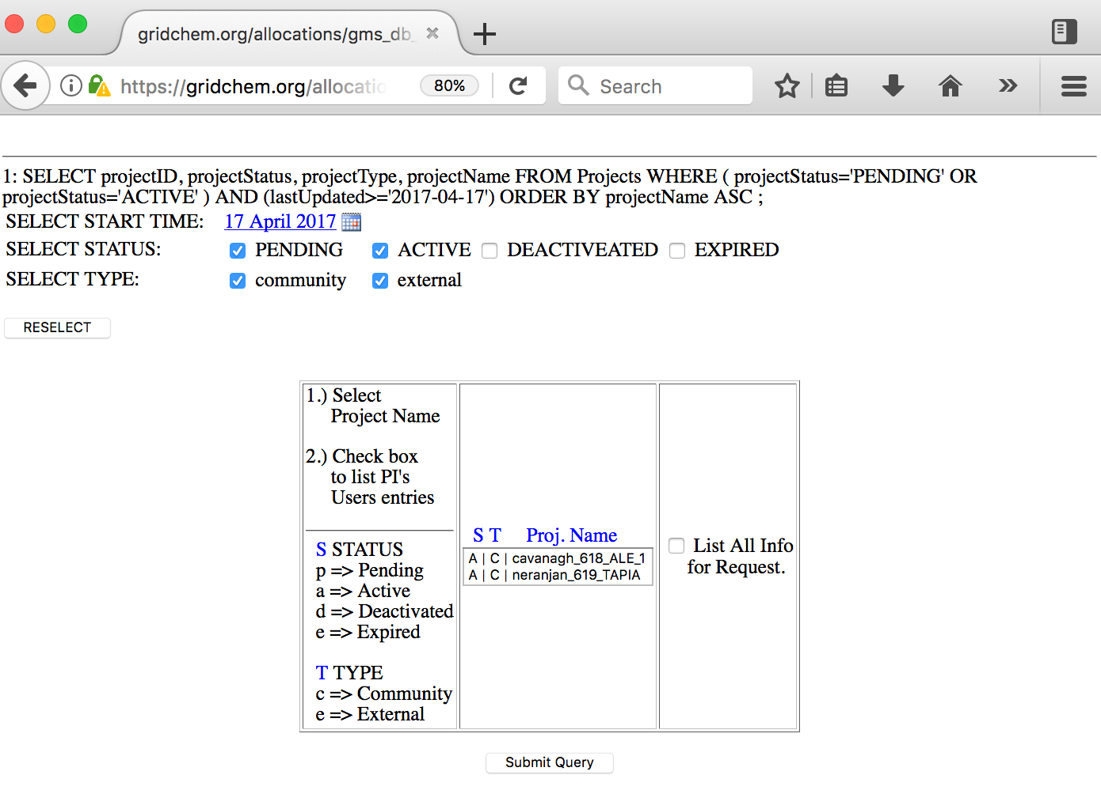
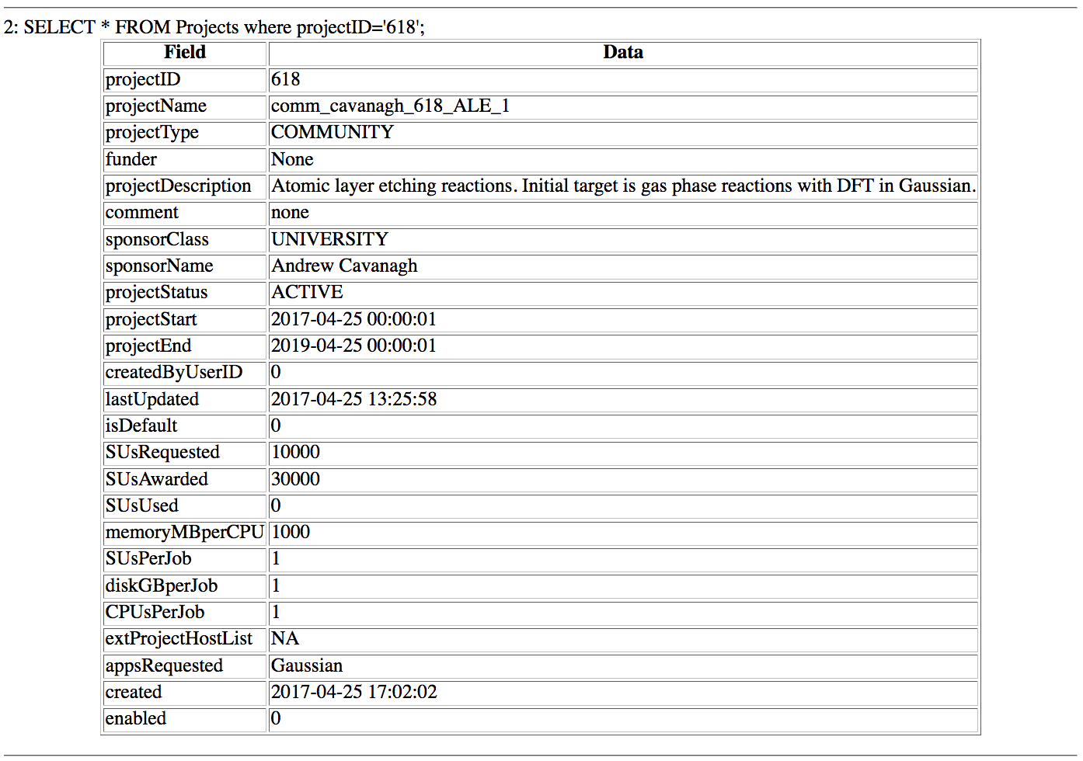
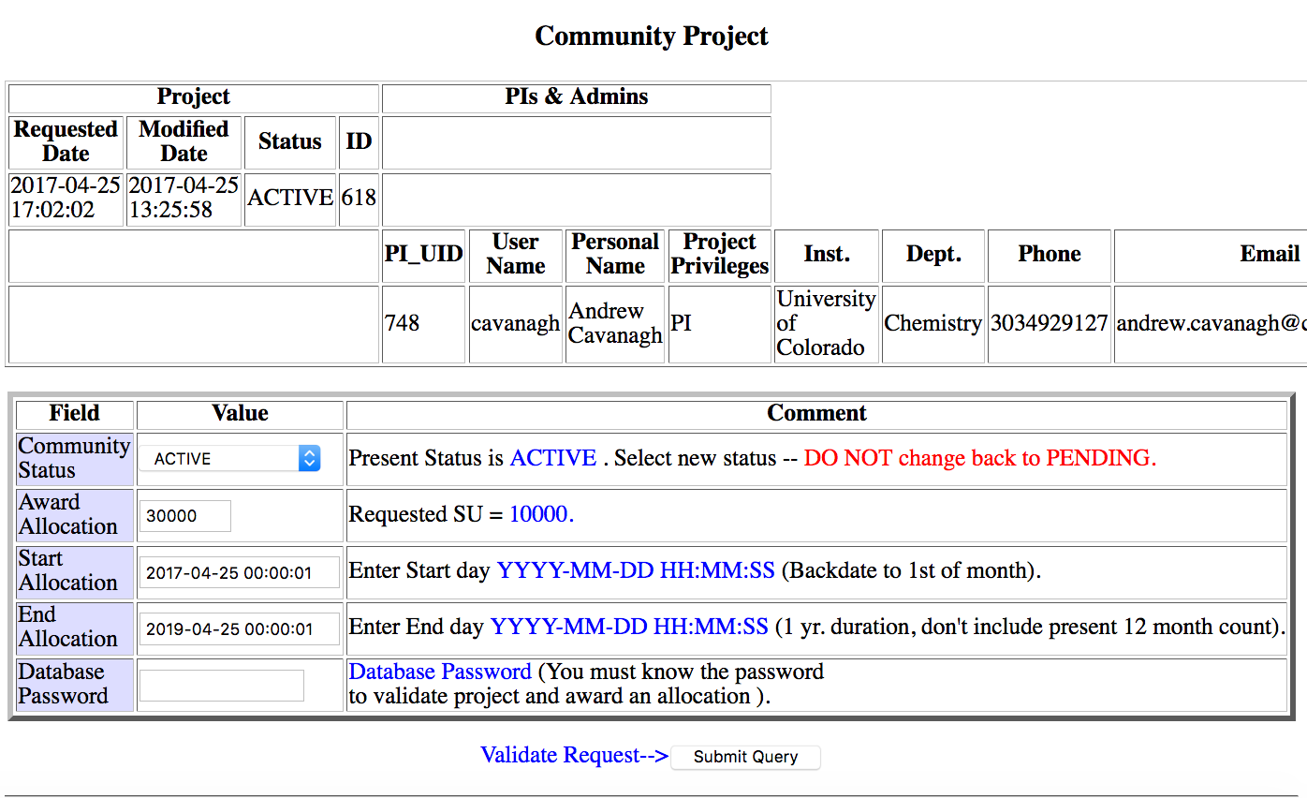
Allocation Processing

Slide 19
Allocation Usage
Granularity | Scope
Job | Resource
User | Resource
Allocation | Resource
User | Project
User | Allocation Type
Project | Allocation Type

Slide 20
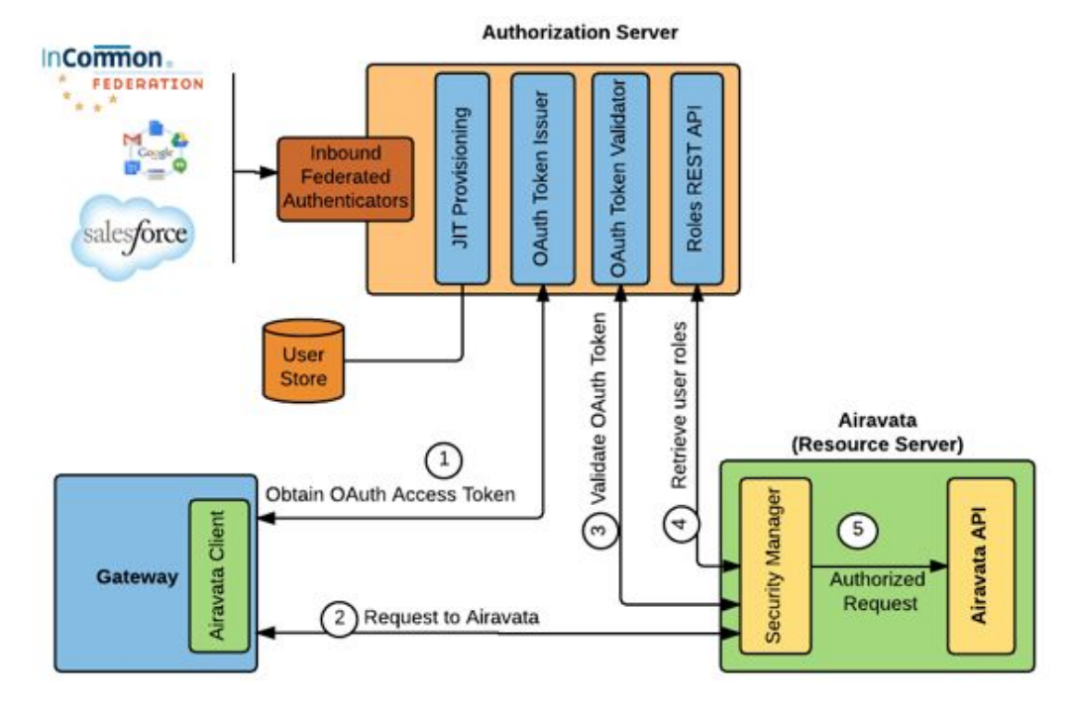
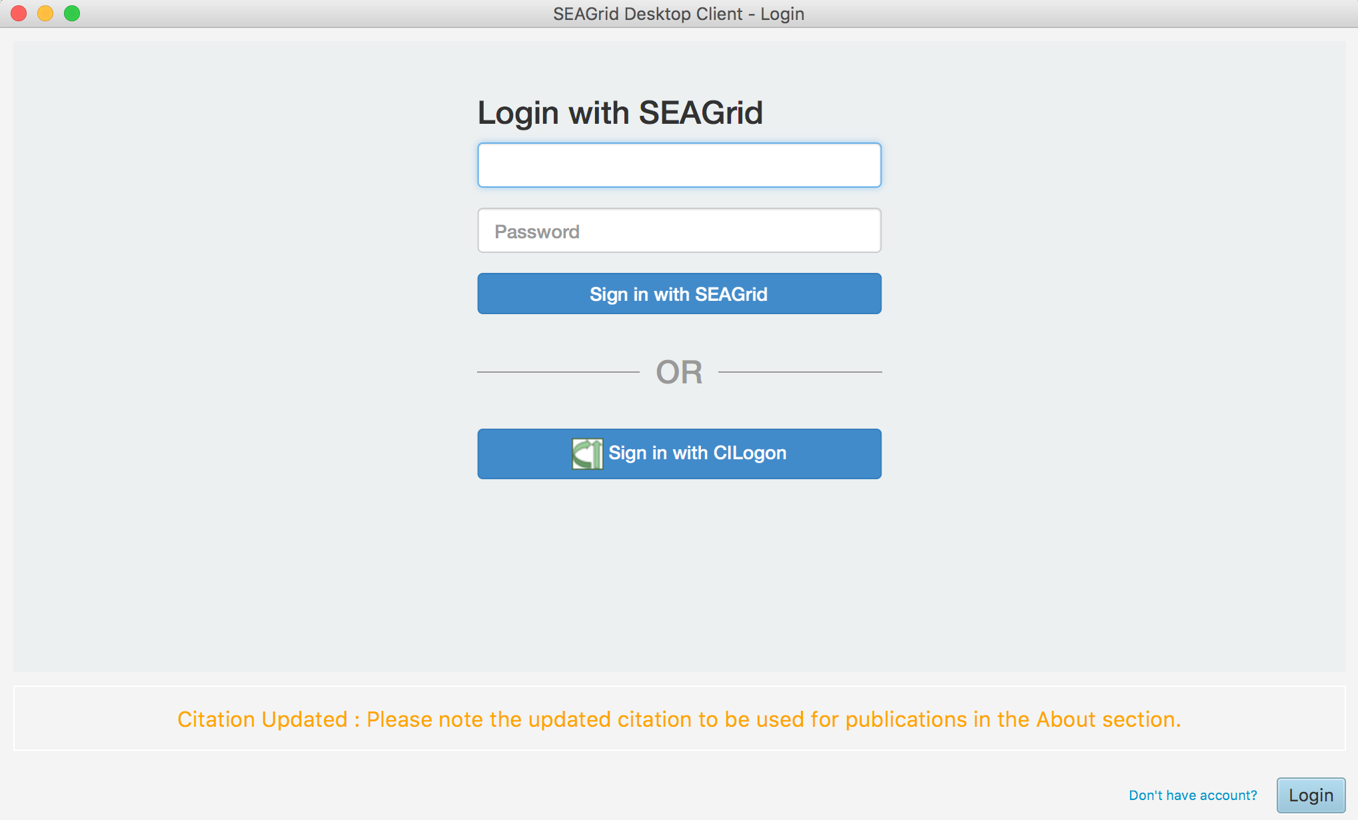
Authentication

Slide 21
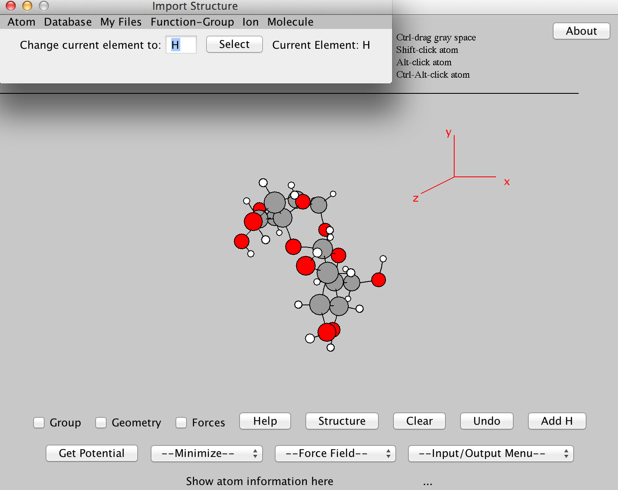
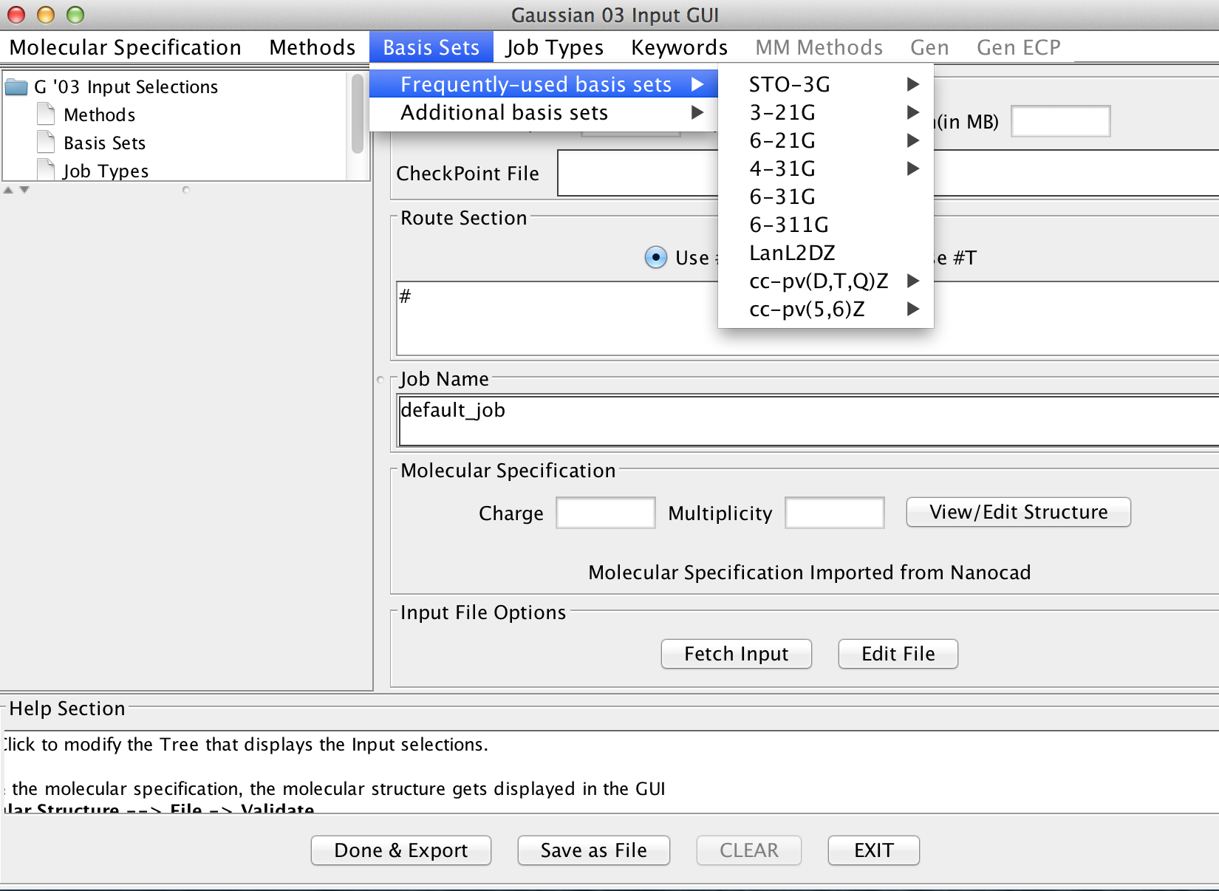
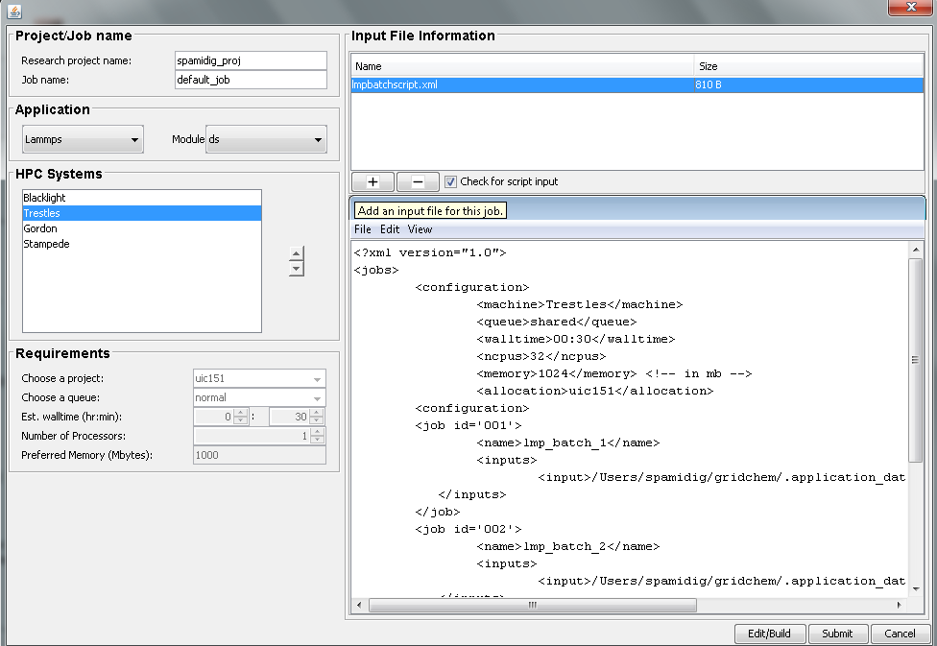
Input Preparation
Molecular Editor
Gaussian Input Generator
Script based multiple input ingester

Slide 22
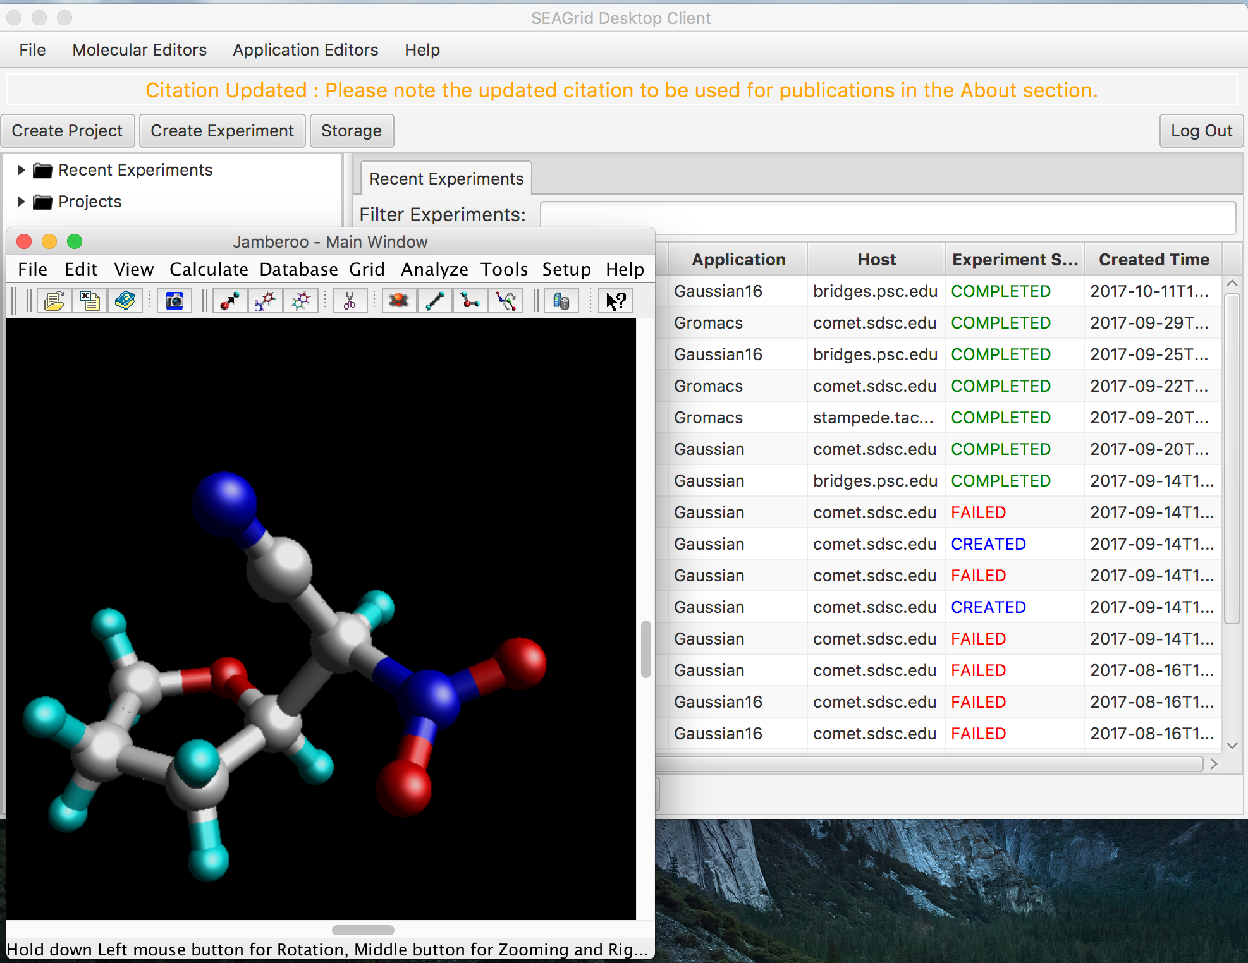
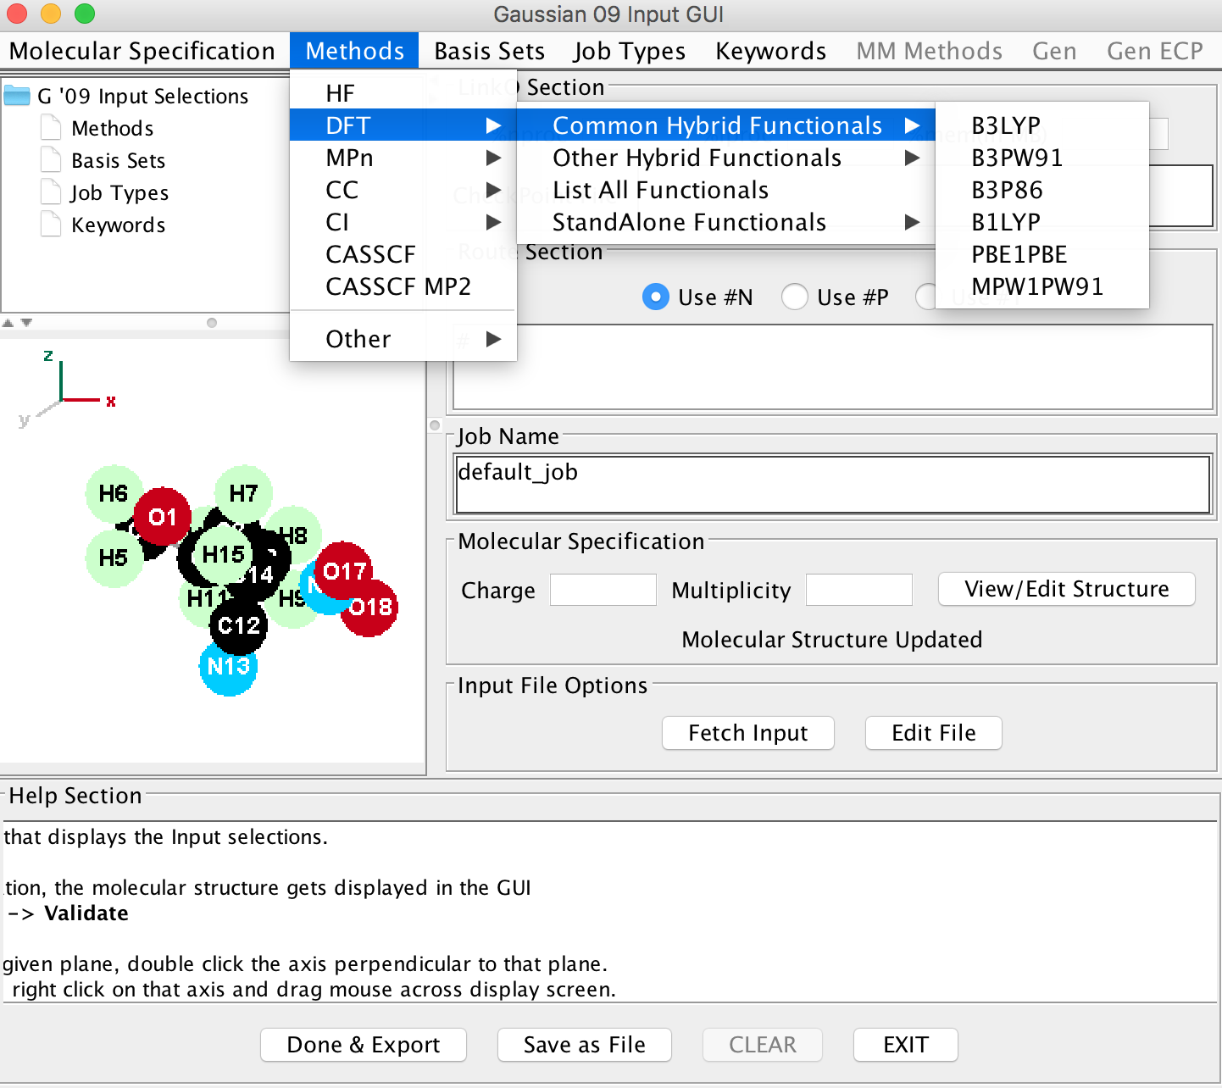
Jamberoo Molecular Editor with Gaussian09 Application Editor GUI

Slide 23
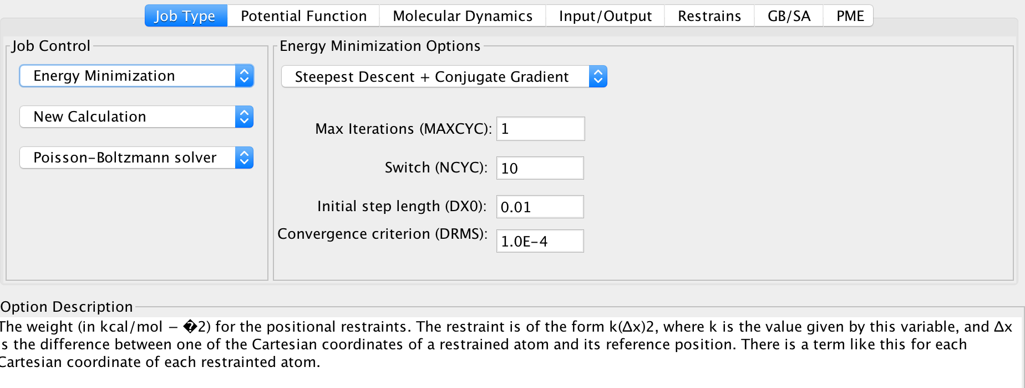
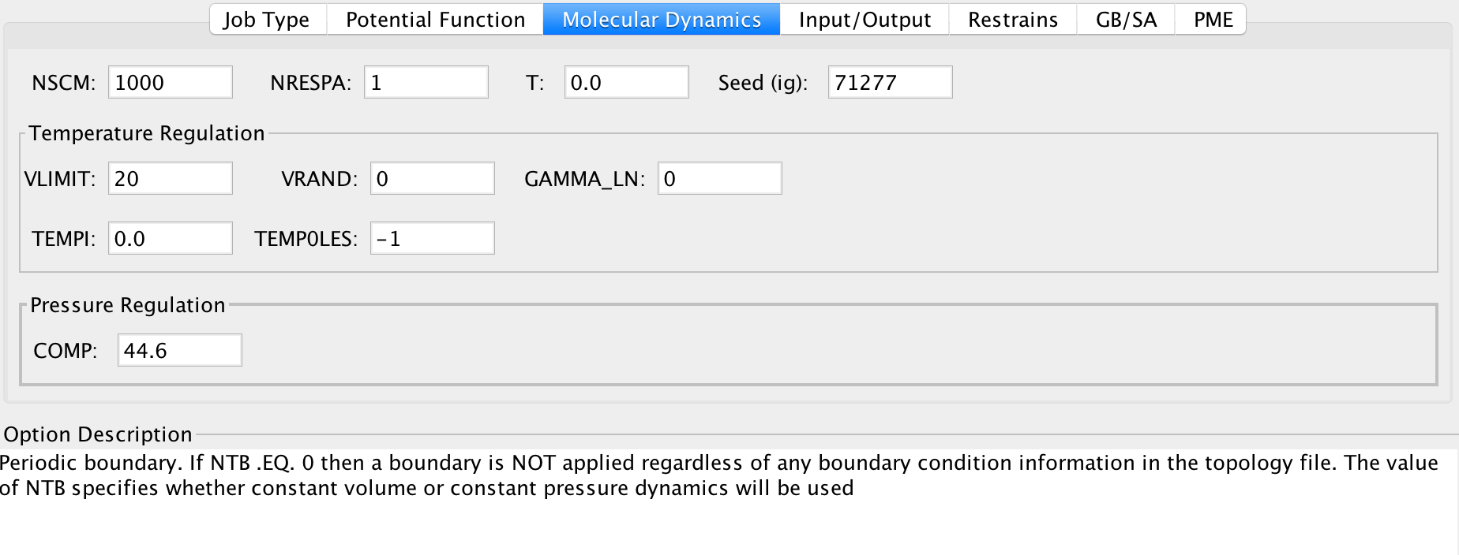
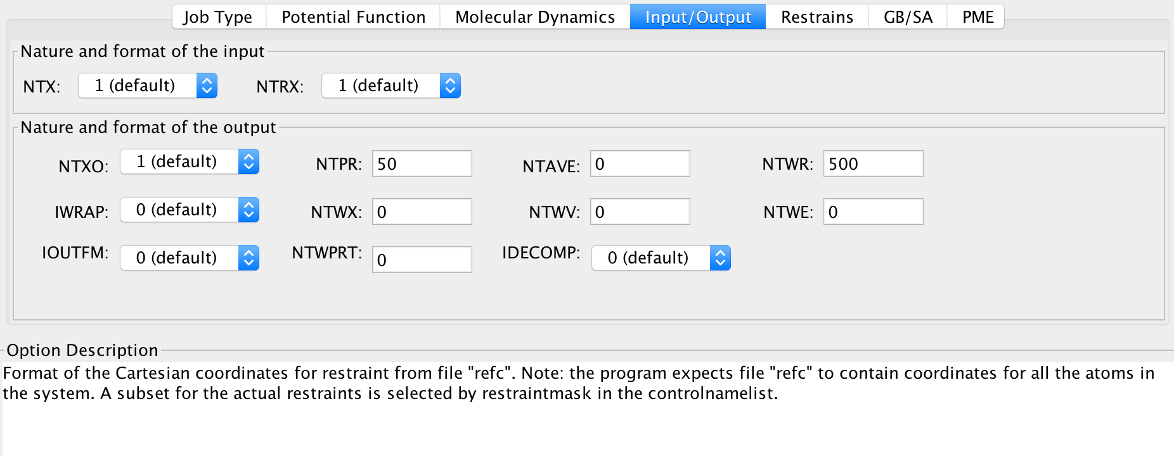
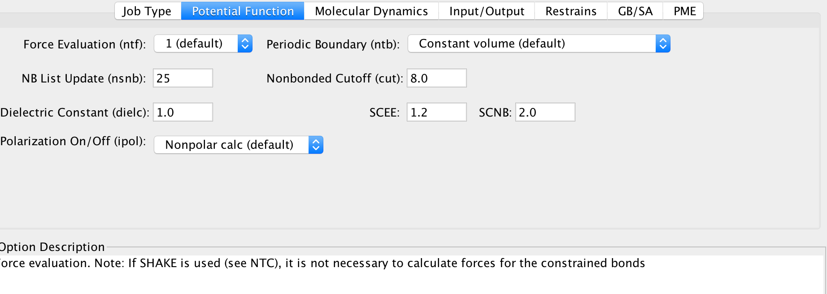
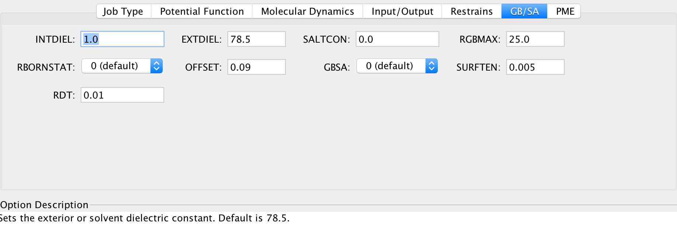
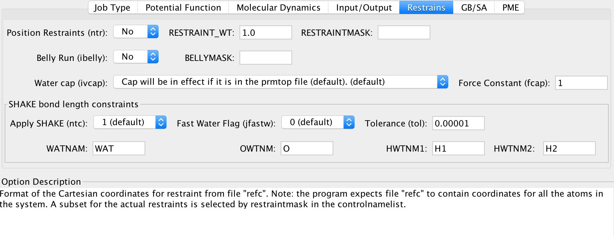
Jamberoo Amber MD Interface

Slide 24



Job Editor with system dynamic data

Slide 25



Job Monitoring

Slide 26

MD Application Interfaces based on GenApp
https://somo.chem.utk.edu/parammd/

Slide 27

What is GROMACSIMUM ?
GROMACSIMUM is a graphical user interface for popular molecular dynamics package, GROMACS. GROMACSIMUM’s combined accuracy and speed make possible long time molecular dynamics simulations.
Seamlessly integrated with newly developed GUI interfaces, GROMACSIMUM provides comprehensive setup, simulation, analysis and job submission tools.
With its highly visual, easy-to-use interface, GROMACSIMUM guides you through each stage of the MD simulation process; in guiding your project workflow, its user friendly environment directs you to a successful outcome.
Users inexperienced in MD can work along prepared workflows, while experts may enjoy a significant relief from the tedium of typing and scripting.

Slide 28
MD Application Interfaces based on GenApp
https://somo.chem.utk.edu/parammd/

Slide 29
Jamberoo Amber MD Interface

Slide 30



Burai QE Gui

Slide 31
What is GROMACSIMUM ?
GROMACSIMUM is a graphical user interface for popular molecular dynamics package, GROMACS. GROMACSIMUM’s combined accuracy and speed make possible long time molecular dynamics simulations.
Seamlessly integrated with newly developed GUI interfaces, GROMACSIMUM provides comprehensive setup, simulation, analysis and job submission tools.
With its highly visual, easy-to-use interface, GROMACSIMUM guides you through each stage of the MD simulation process; in guiding your project workflow, its user friendly environment directs you to a successful outcome.
Users inexperienced in MD can work along prepared workflows, while experts may enjoy a significant relief from the tedium of typing and scripting.

Slide 32

SEAGrid Desktop Client Storage Browser

Slide 33

Job Parameter Editor

Slide 34
Job Validation
Input Validation
Right Input for Right Application Software
All files/Data needed are available/retrievable or not
Job Parameter validation – Right Queues, Right Resources [time (amount?), Processors, Memory, Quality of Service, Reservation etc..
Application
HPC Resource(s)
If workflow, for each step, this has to be done.
Input Parsing

Slide 35

Job History

Slide 36

Job Monitoring

Slide 37



Job Output

Slide 38

Gradient Monitoring

Slide 39

Post Processing - Spectra

Slide 40


Post Processing

Slide 41
Metascheduling
Some resources limit number of jobs
Multiple connections for large number of jobs can be considered “Denial of service” attack.
It could be more efficient to distribute large number of jobs
Job packing, Job arrays support
Automated job submissions for optimizing resources and time to solution

Slide 42

MetaScheduling Proposed architecture

Slide 43

SEAGrid Data Catalog

Slide 44


Searching for Cataloged Data

Slide 45



Metadata

Slide 46




Parametrization Methodology and Schemes

Slide 47


Apache Airavata Workflow Dihedral Parametrization

Slide 48


Workflow Monitoring and Validation of the dihedral parameters

